Slide 1
A Comparative Study of OLETS and other Minimax Algorithms in Standard American Checkers
ST264010

Slide 2
Introduction

Slide 3

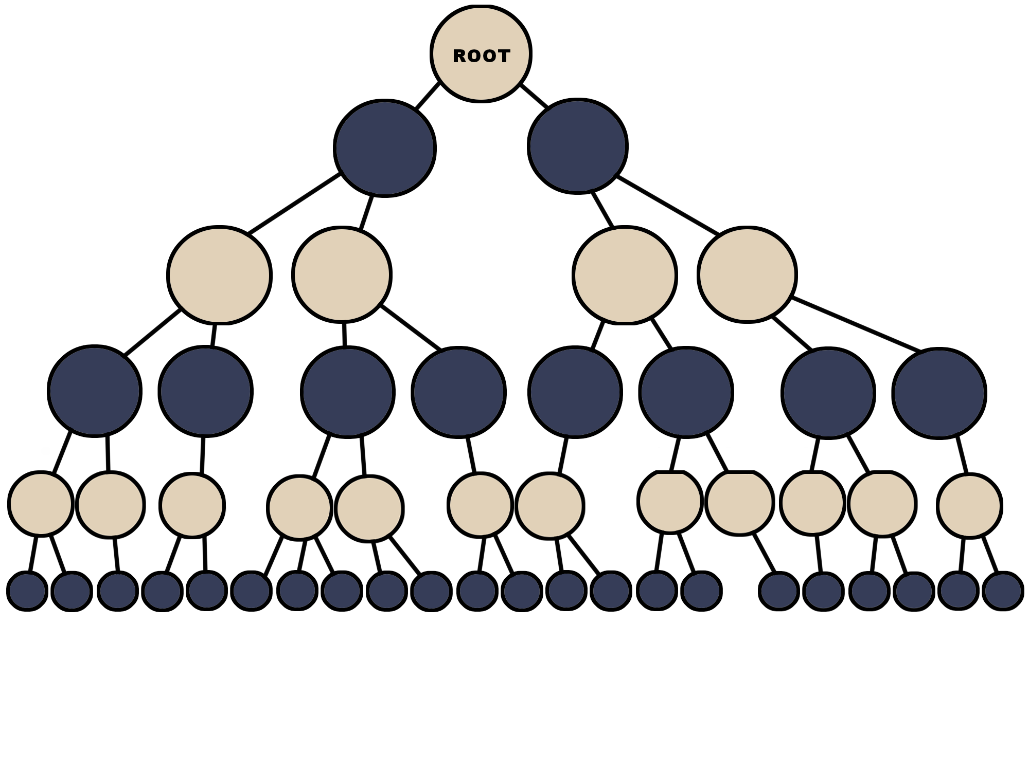






Slide 4
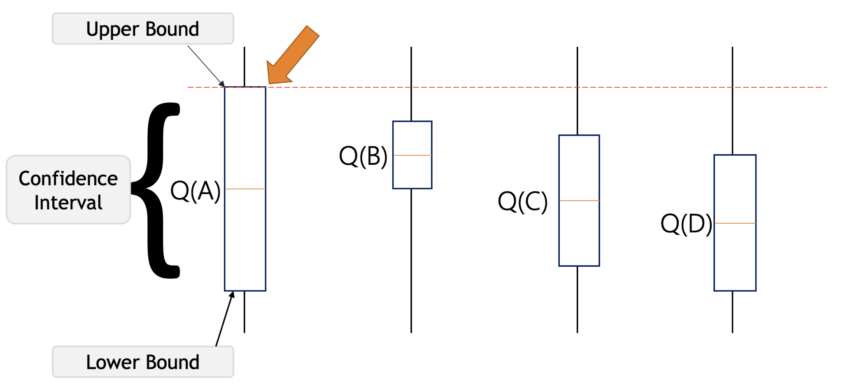
node.wins / (node.visits + .0001f) + (ExplorationThreshold * Mathf.Sqrt(Mathf.Log(node.parent.visits) / (node.visits + .0001f)))

Slide 5
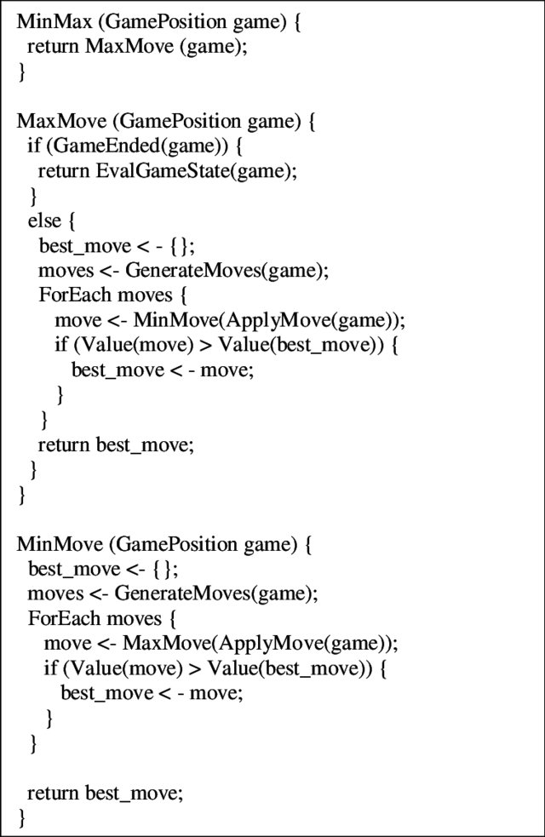
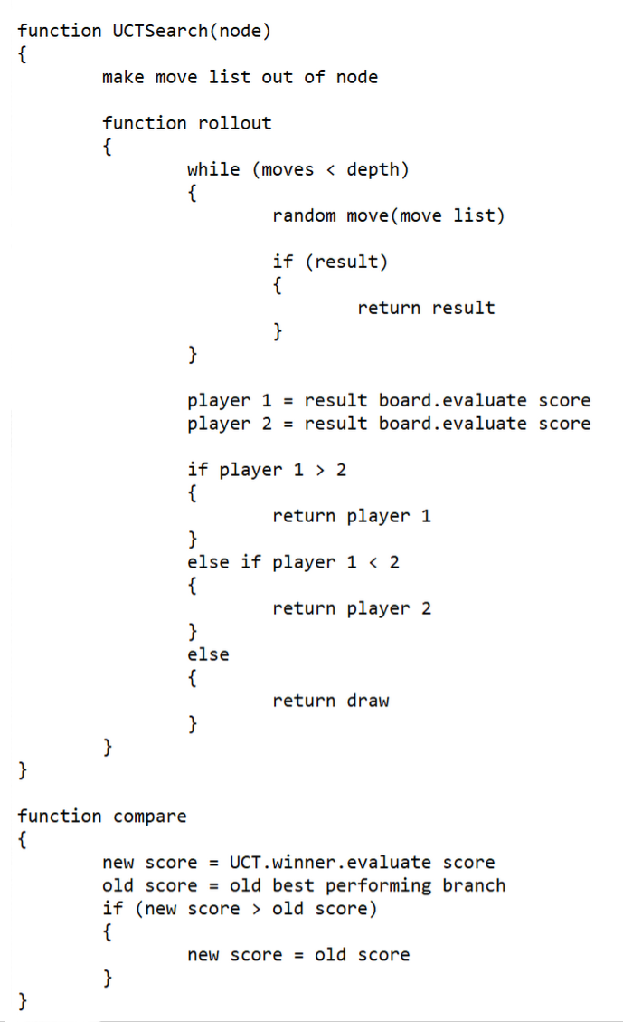
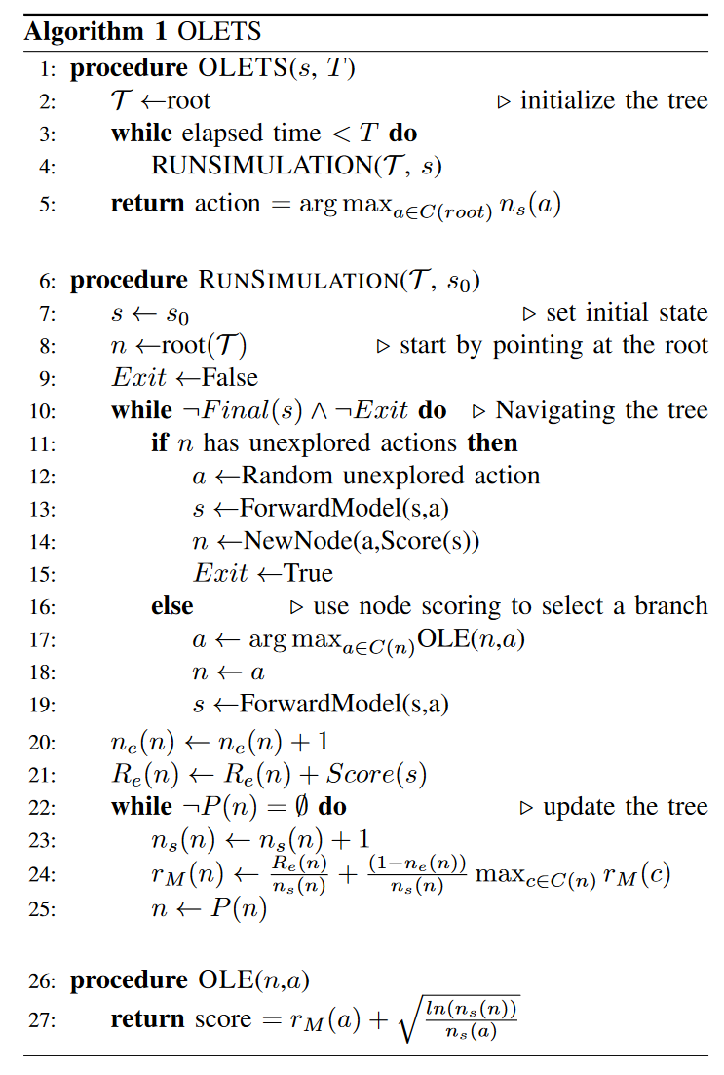

Slide 6
RQ: How does OLETS compare against UCT for correctness over computation time in calculating moves for American Standardised Checkers?
H1: UCT will yield better results while requiring less computation time.
H2: OLETS will yield better results while requiring less computation time.
HNULL: There is no significant difference between the 2 algorithms when it comes to correctness over computation time.

Slide 7
Research Methodology

Slide 8
Tests
Completeness:
If the algorithm finds a solution in the case where one exists
Complexity
The number of nodes generated
Optimality
Whether the algorithm always finds the best solution

Slide 9
Tests
Problem solving
The algorithms will be given problems to solve
Match ups
The algorithms will be tested against each other

Slide 10
Software Development
Development Lifecycle
Waterfall based work model
Benchmark testing
Code Quality Assurance
Coding standards
Unit tests
Experiment Quality Assurance
Test Variety
Quantitative data
Control group
Test iteration

Slide 11
Ethical Considerations
Low Risk Research
Falmouth Research Integrity Policy

Slide 12


Slide 13
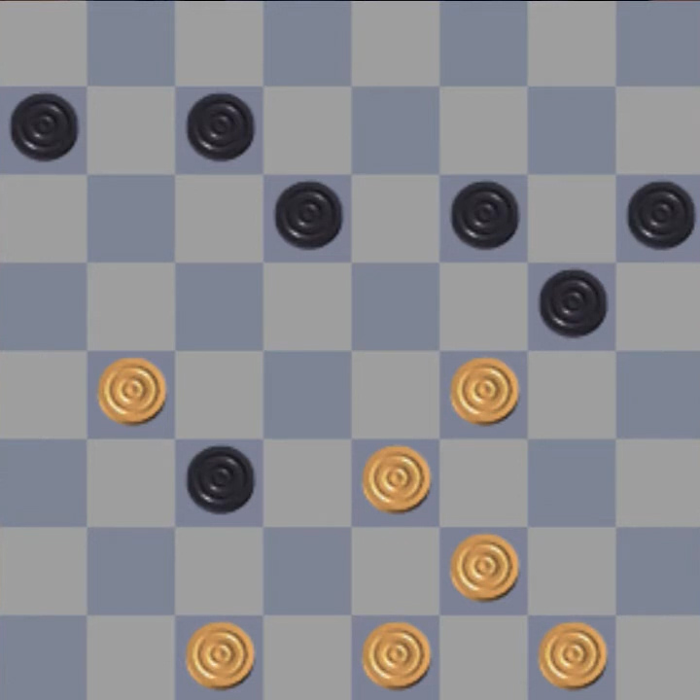
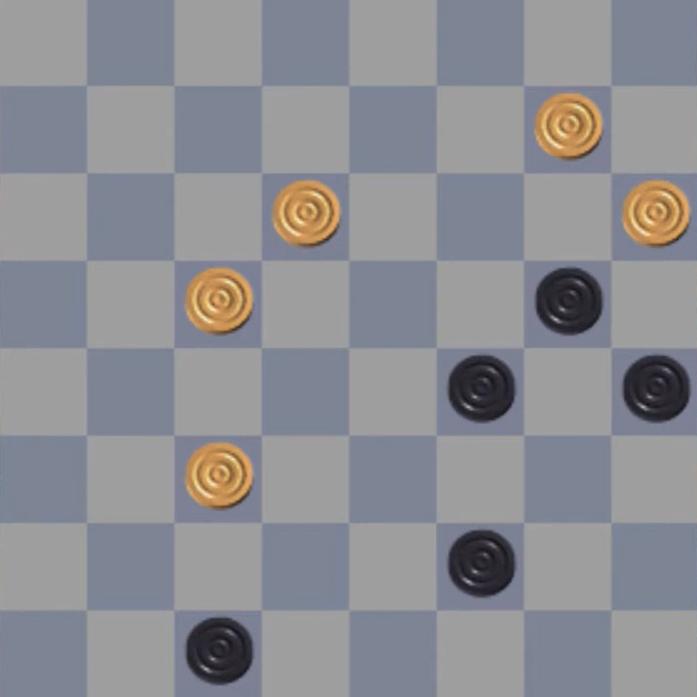
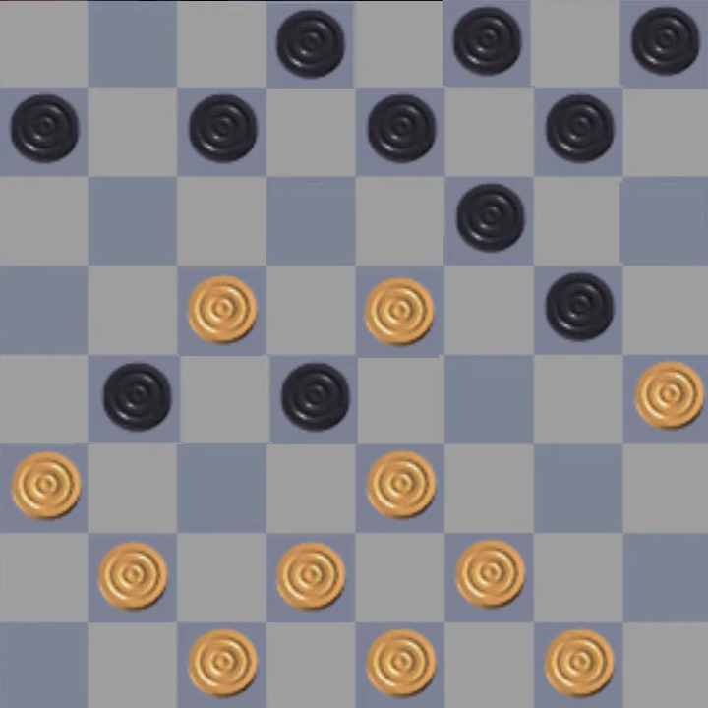
Tests - Problem Solving

Slide 14
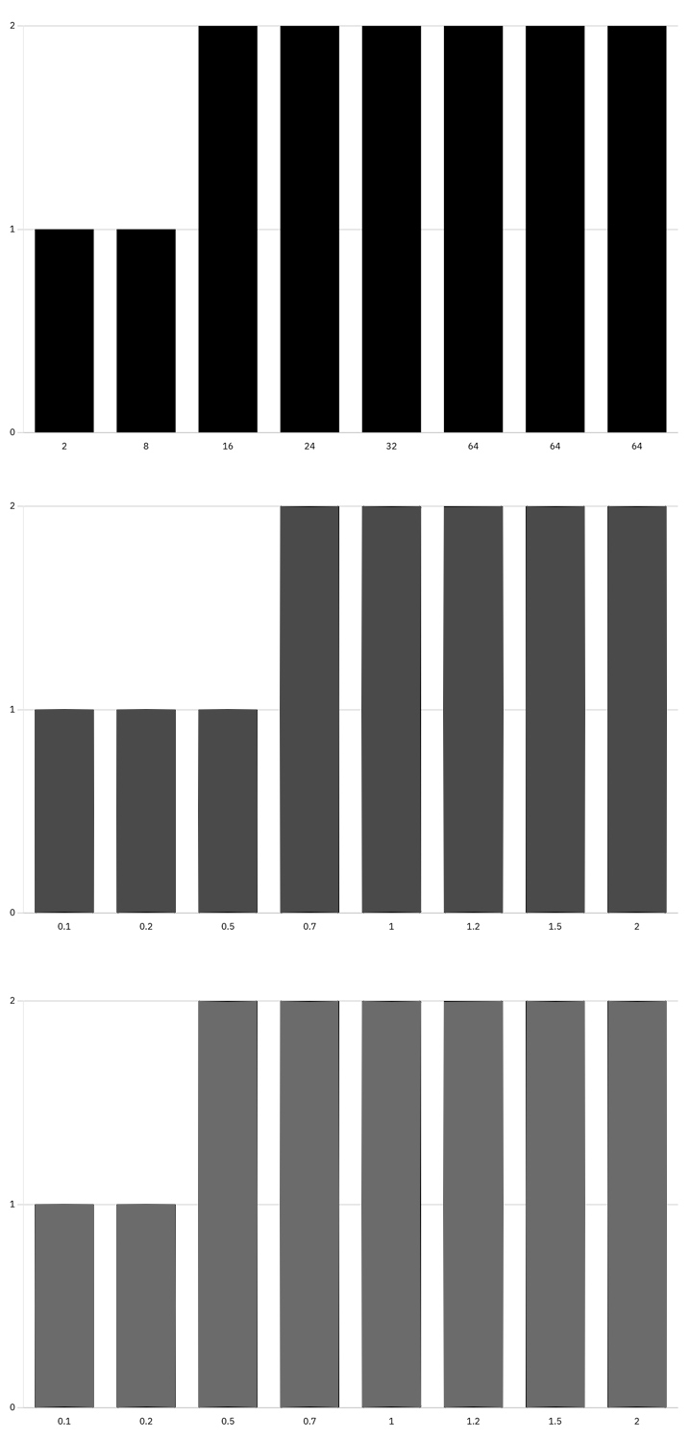
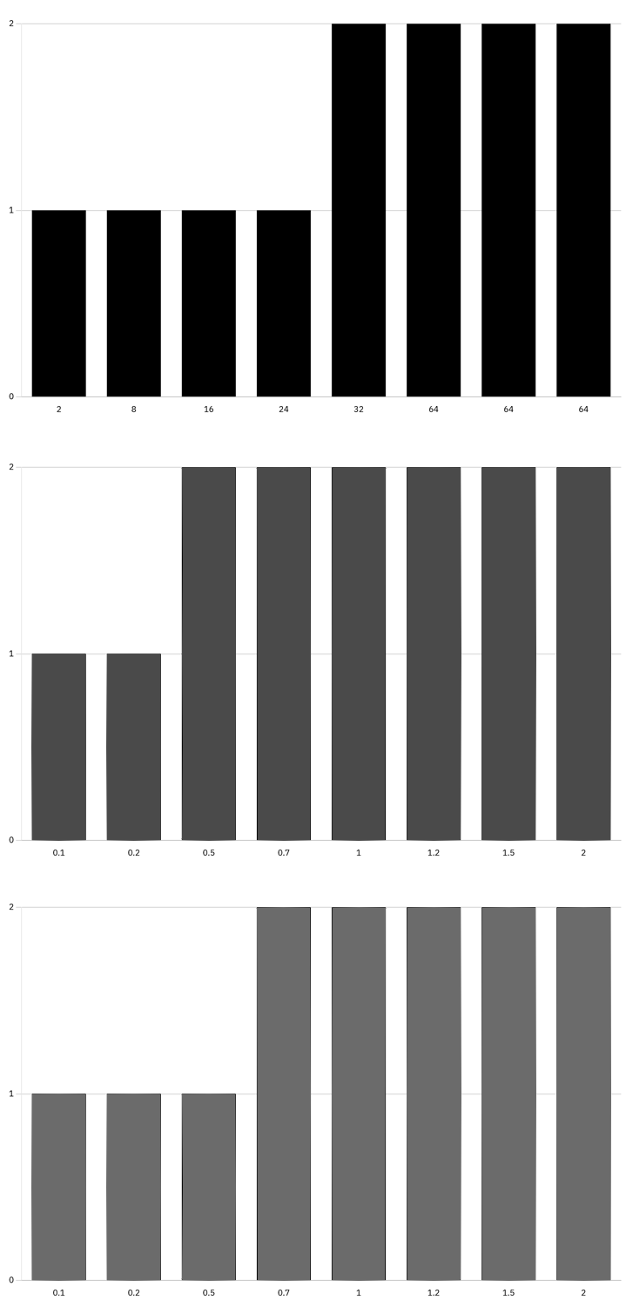
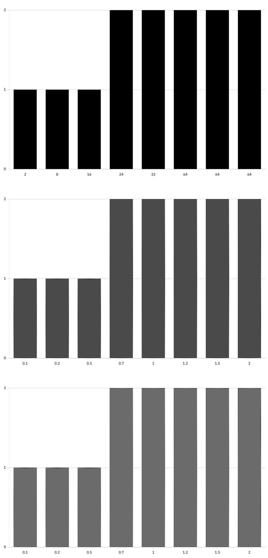

Slide 15
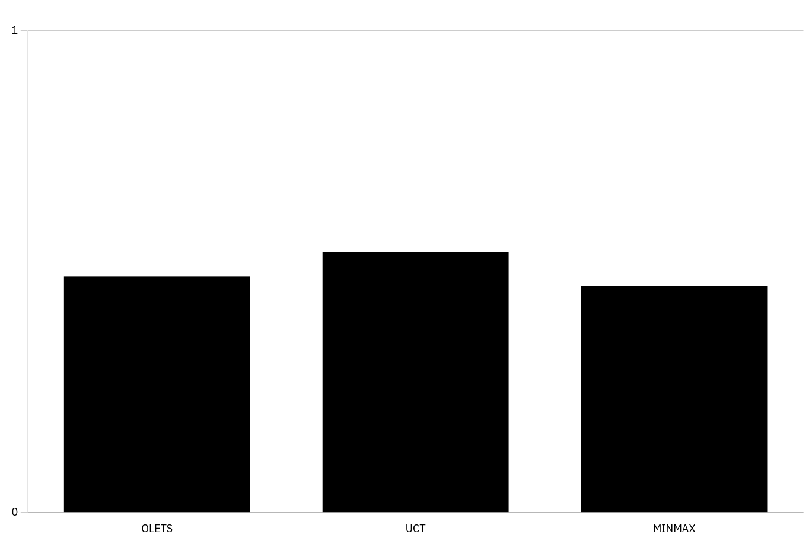
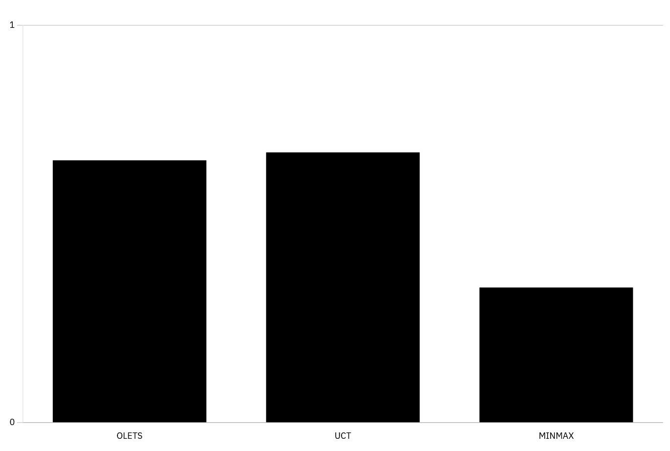
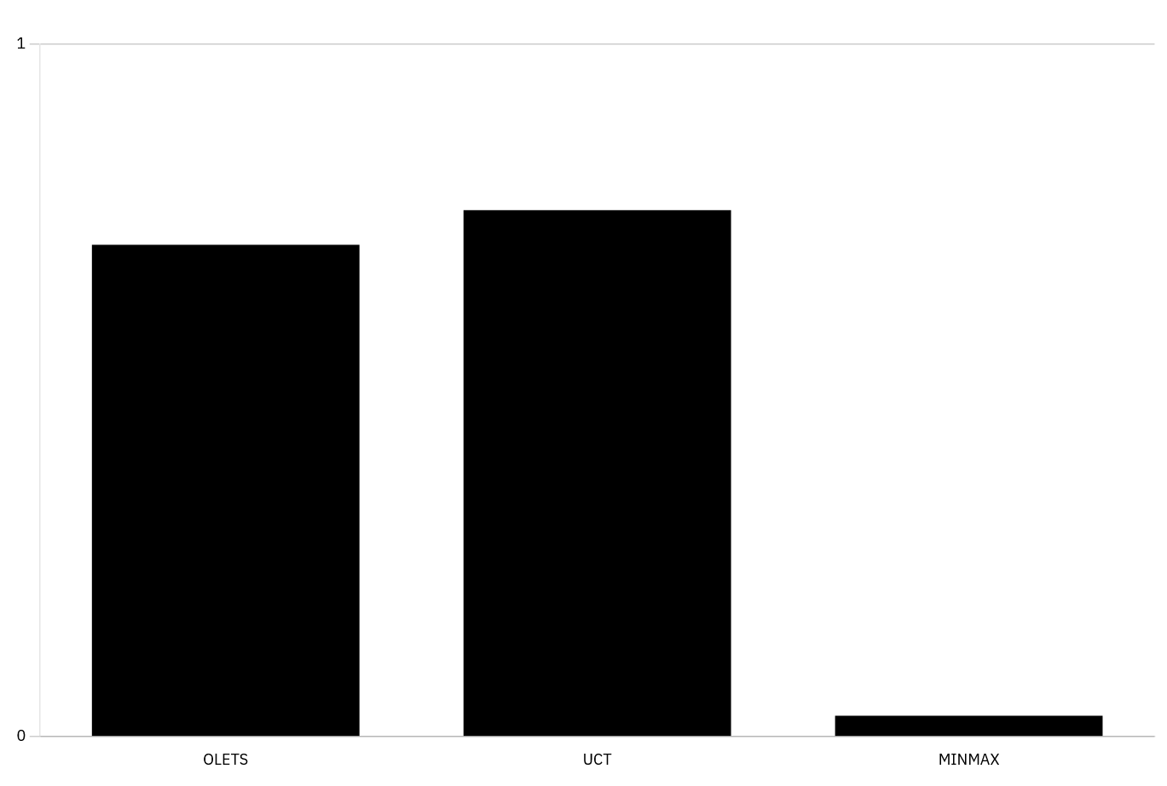

Slide 16
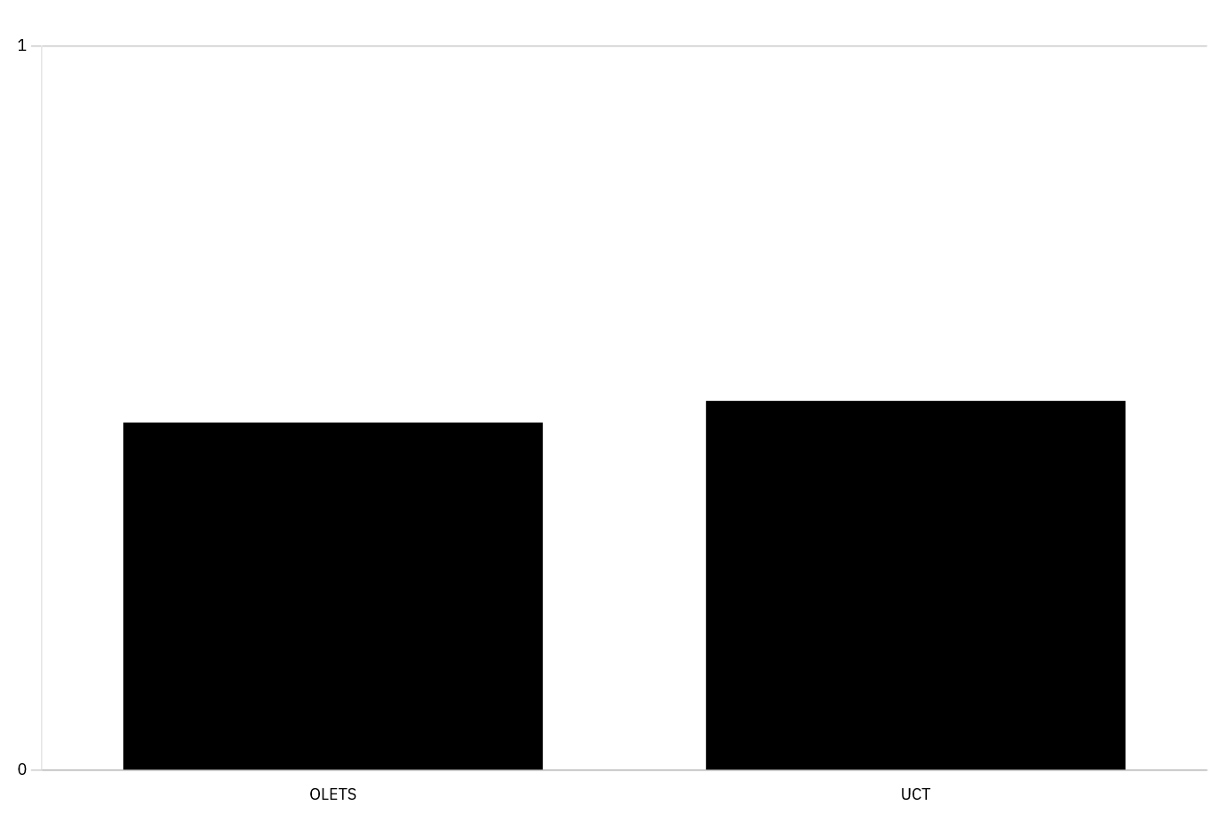

Slide 17
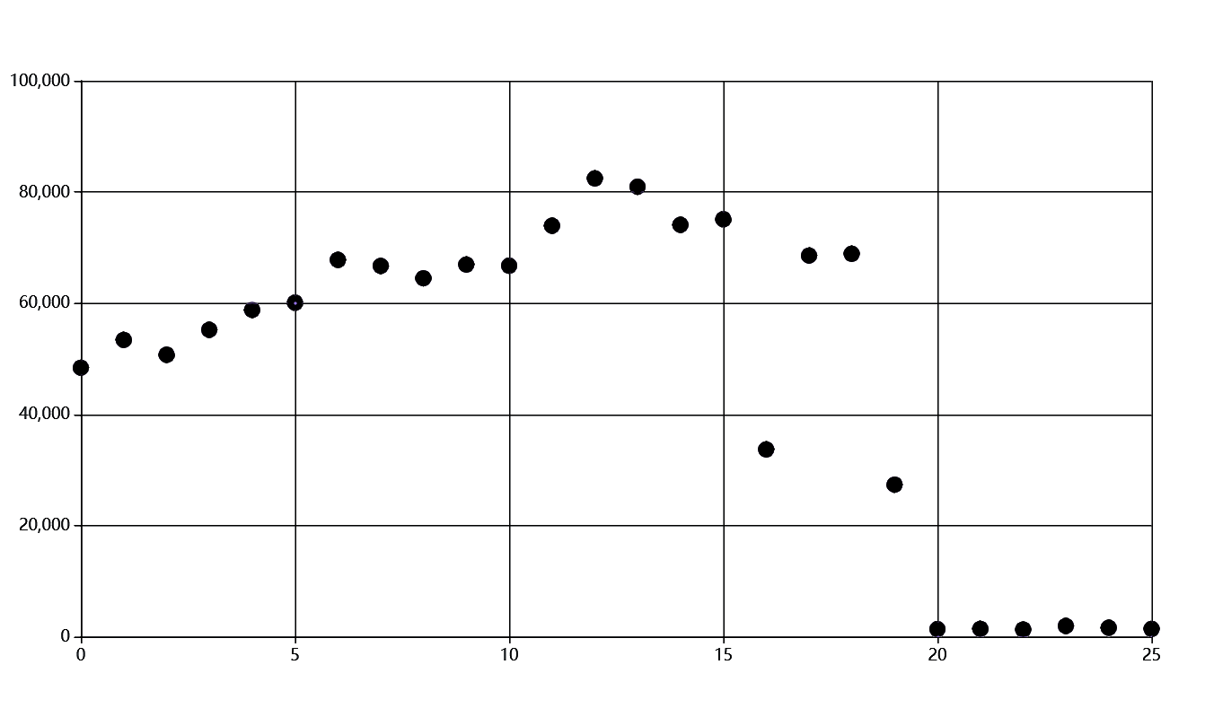
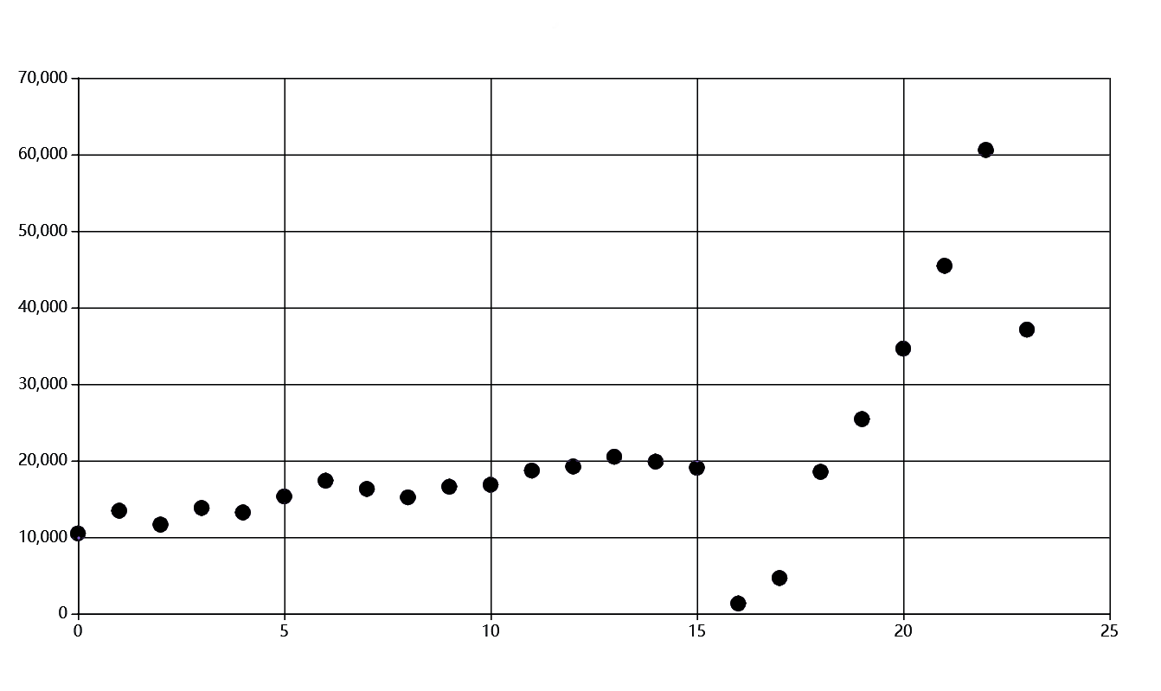
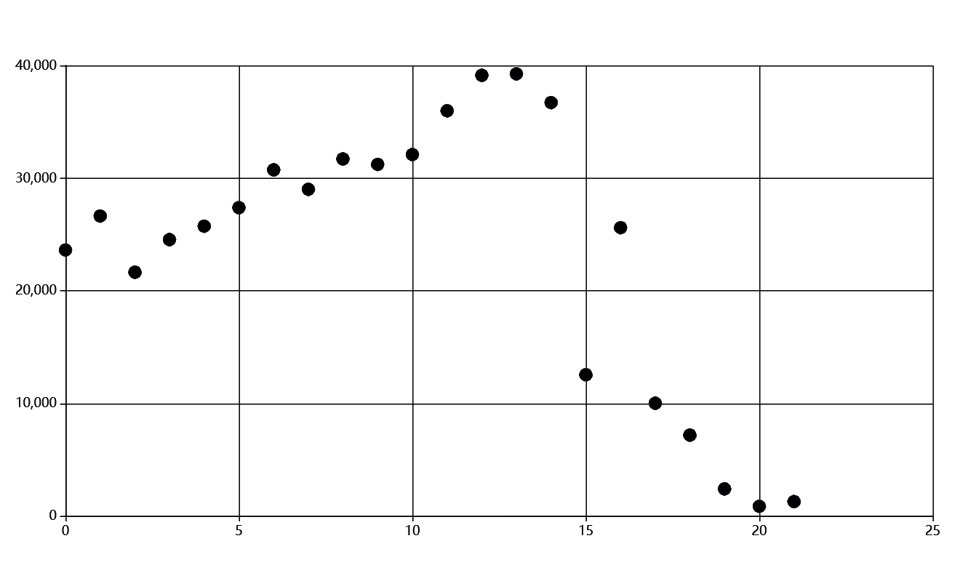
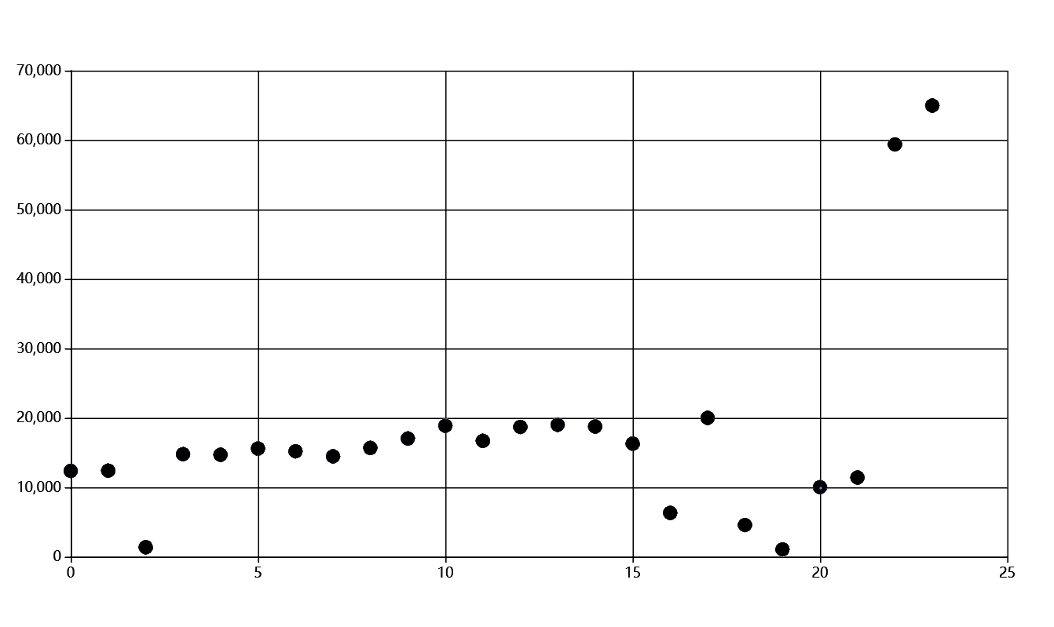
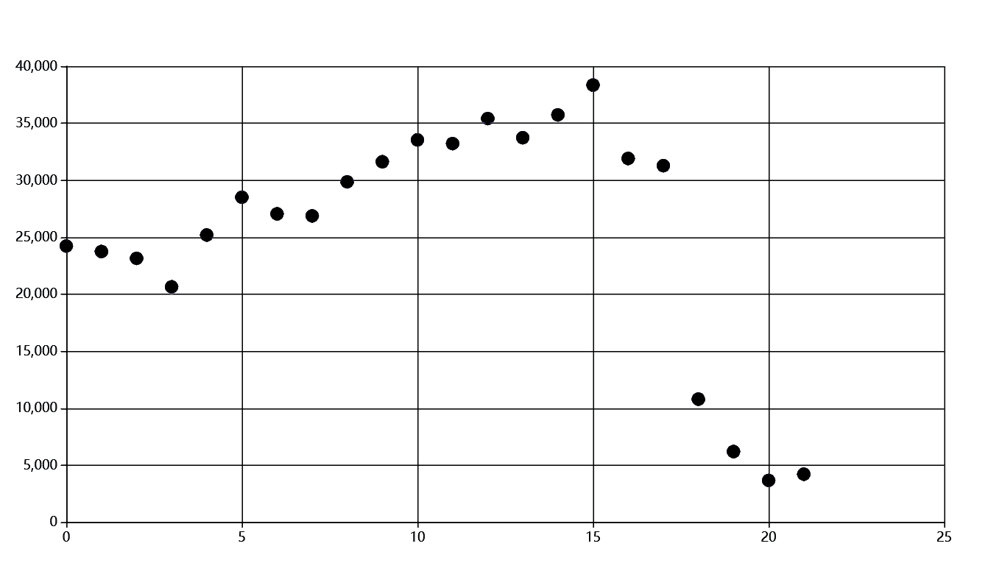
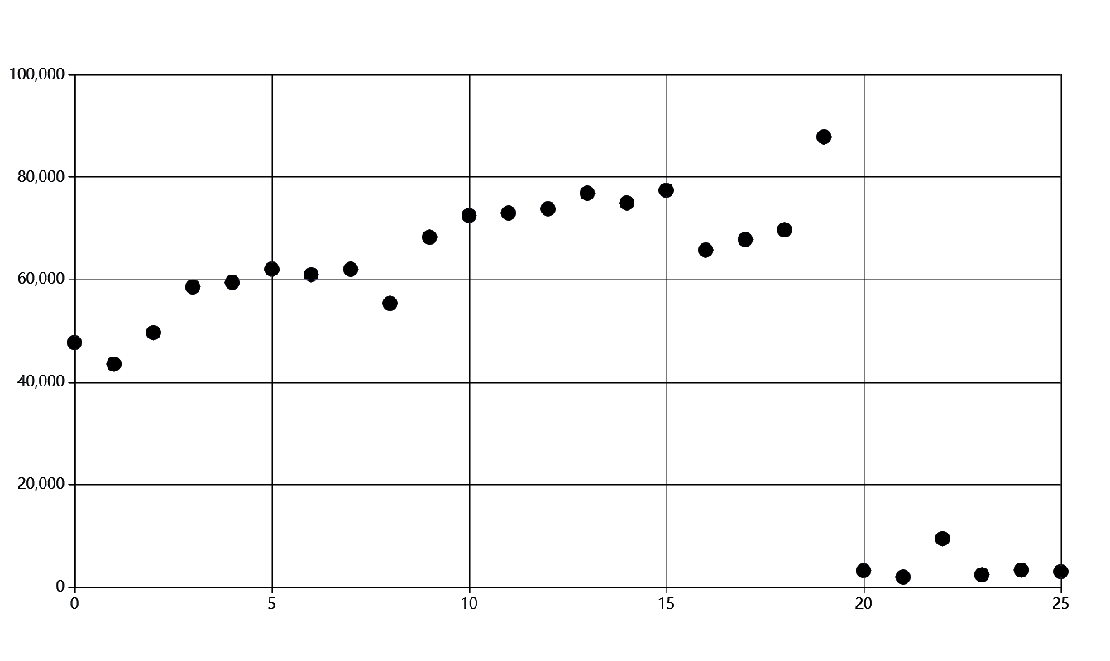

Slide 18
Conclusion

Slide 19
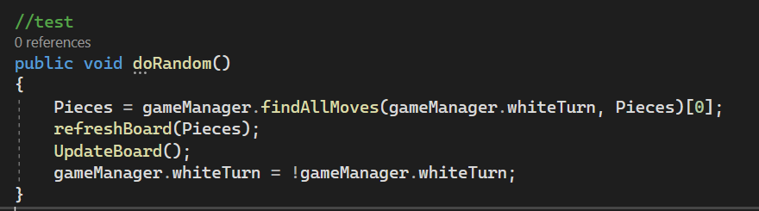
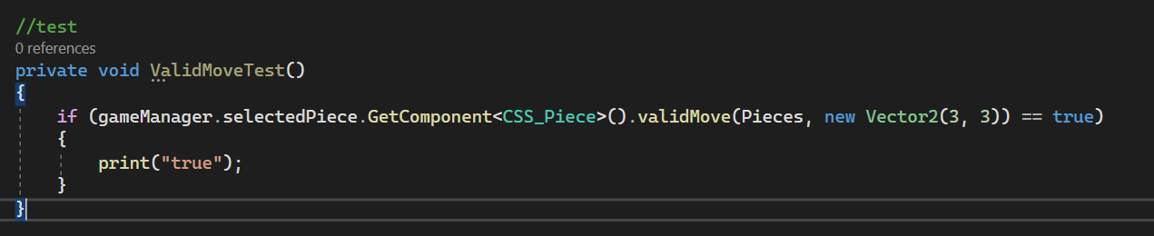
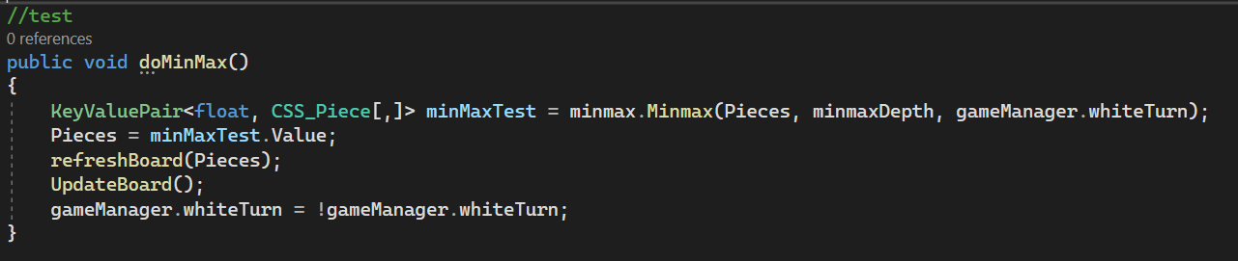
UNIT TESTS

Slide 20
R-CODE
#bar graph for first series of tests
setwd("C:/Users/Stefanie/DataResults") # file path
# read data
my_data <- read.csv("MINMAX_T1.txt")
library(ggplot2)
#bar plot
ggplot(my_data, aes(x = Category, y = Count)) +
geom_bar(stat = "identity") +
theme_minimal()
library(ggplot2)
# Create scatter plot
ggplot(data, aes(x = x, y = y)) +geom_point(color = "blue") +labs(title = "Search Depth UCT", x = "Nodes", y = "Turn") + theme_minimal()

Slide 21
CODE SNIPPETS

